Slide 2
Objectives Overview
Explain the purpose of an operating system
Describe the start-up process and shutdown options on computers and mobile devices
Explain how an operating system provides a user interface, manages programs, manages memory, and coordinates tasks
Describe how an operating system enables users to configure devices, establish an Internet connection, and monitor performance
Identify file management and other tools included with an operating system, along with ways to update operating system software
See Page 410
for Detailed Objectives

Slide 3
Objectives Overview
Explain how an operating system enables users to control a network or administer security
Summarize the features of several desktop operating systems
Briefly describe various server operating systems
Summarize the features and uses of several mobile operating systems
See Page 410
for Detailed Objectives

Slide 4
Operating Systems
An operating system (OS) is a set of programs that coordinate all the activities among computer or mobile device hardware
Start and shut down a computer or mobile device
Provide a user interface
Manage programs
Manage memory
Coordinate tasks
Configure devices
Monitor performance
Provide file management and other device or media-related tasks
Updating operating system software
Control a network
Administer security
Establish an Internet connection
Page 410

Slide 5
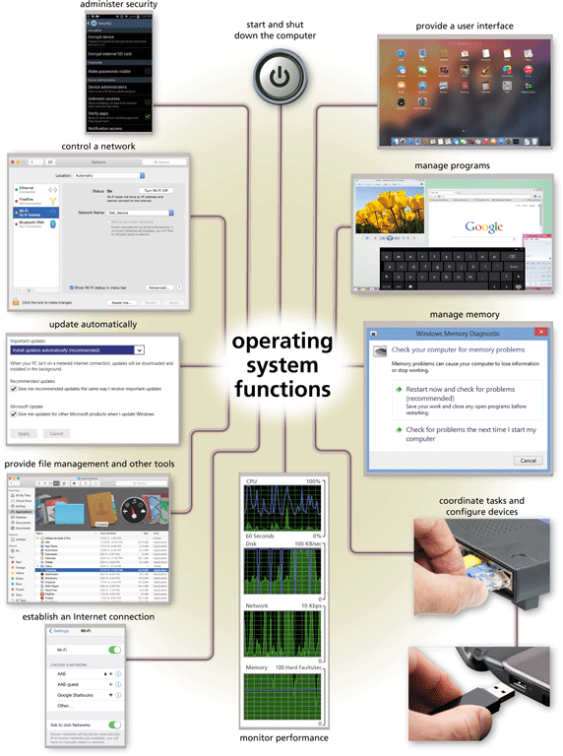
Operating Systems
Page 411
Figure 9-1

Slide 6
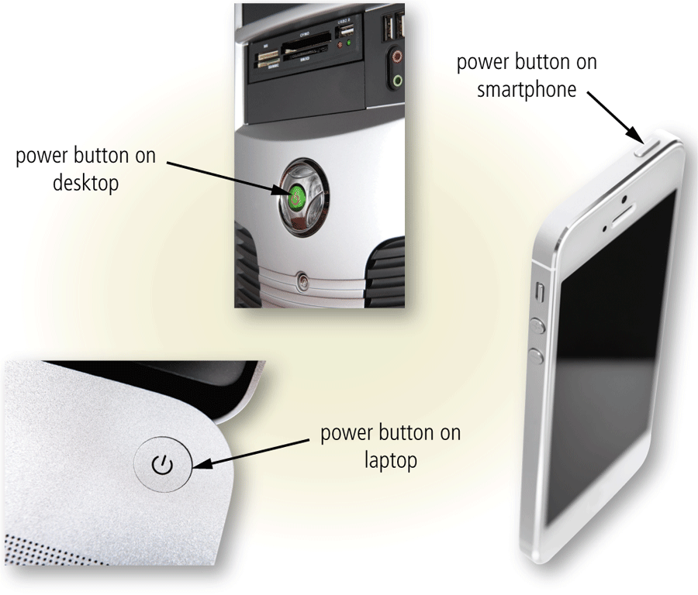
Operating System Functions
Starting Computers and Mobile Devices
If a computer or mobile device is off, you press a power button to turn it on
Page 412
Figure 9-2

Slide 7
Operating System Functions
An operating system includes various power options
Sleep mode saves any open documents running programs or apps to RAM, turns off all unneeded functions, and then places the computer in a low-power state
Hibernate mode saves any open documents and running programs or apps to an internal hard drive before removing power from the computer or device
Page 413

Slide 8
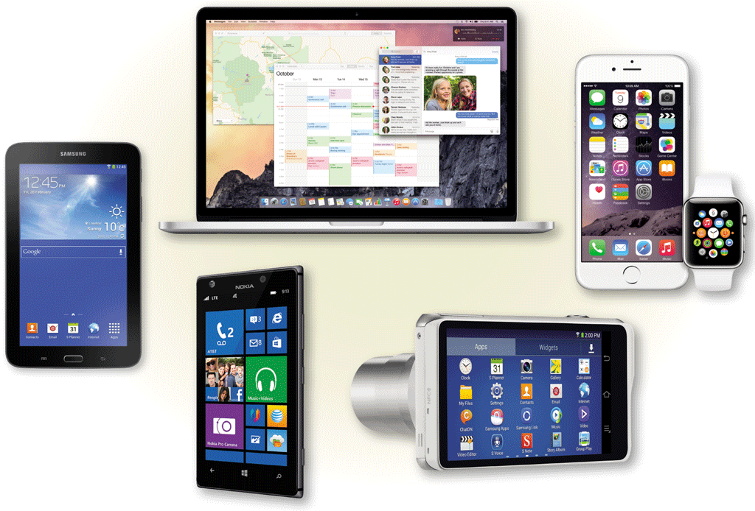
Operating System Functions
A user interface (UI) controls how you enter data and instructions and how information is displayed on the screen
With a graphical user interface (GUI), you interact with menus and visual images
Pages 413– 414
Figure 9-3

Slide 9
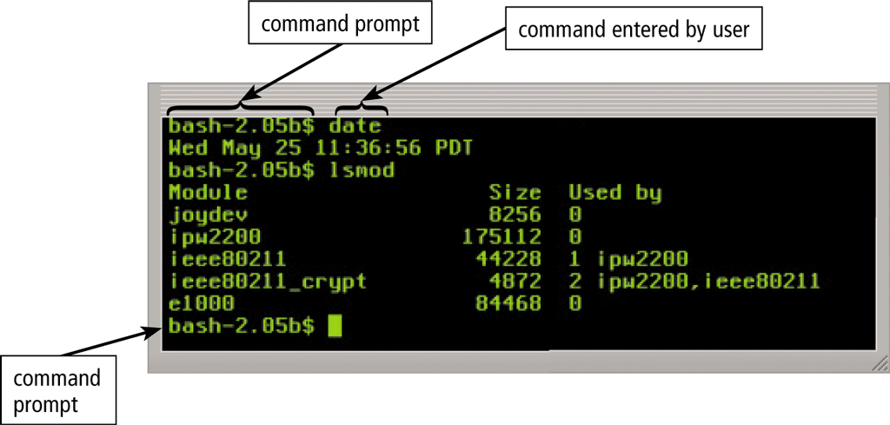
Operating System Functions
In a command-line interface, a user types commands represented by short keywords or abbreviations or presses special keys on the keyboard to enter data and instructions
Pages 414 - 415
Figure 9-4

Slide 10
Operating System Functions
How an operating system handles programs directly affects your productivity
Single tasking and multitasking
Foreground and background
Single user and multiuser
Pages 415 - 416

Slide 11
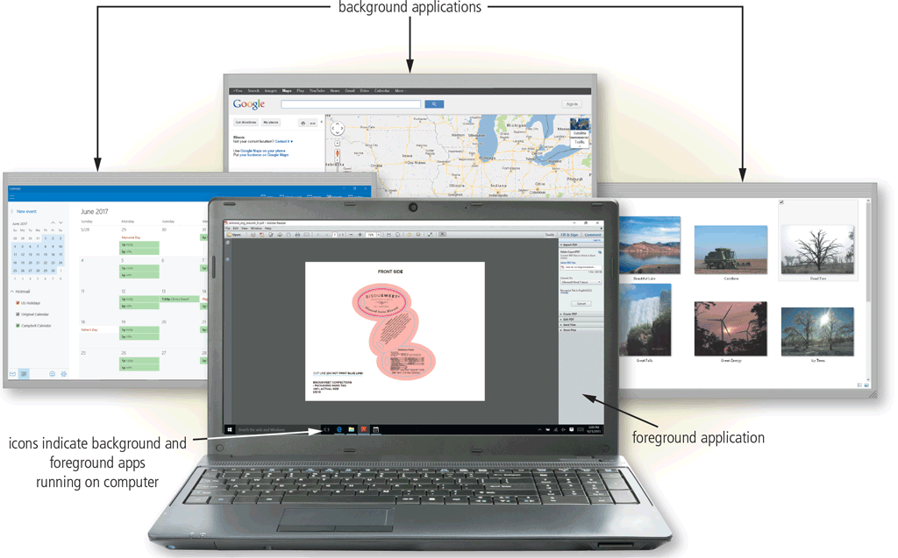
Operating System Functions
Page 415
Figure 9-5

Slide 12
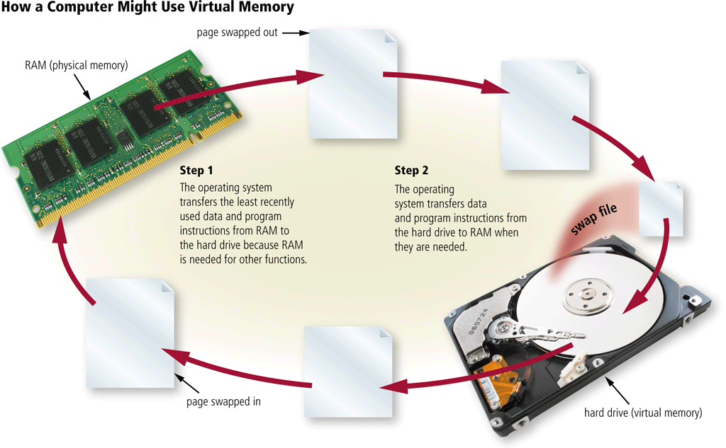
Operating System Functions
Memory management optimizes the use of the computer or device’s internal memory
Virtual memory is a portion of a storage medium functioning as additional RAM
Pages 416 - 417
Figure 9-8

Slide 13
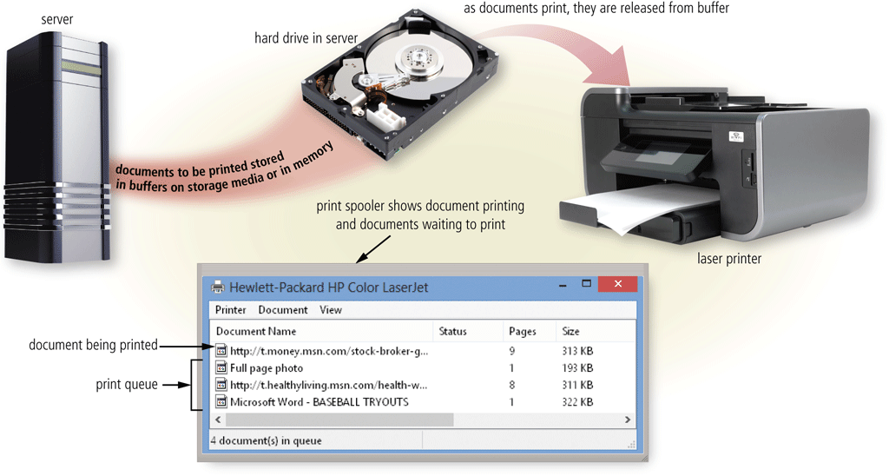
Operating System Functions
The operating system determines the order in which tasks are processed
Pages 418 – 419
Figure 9-9

Slide 14
Operating System Functions
A driver is a small program that tells the operating system how to communicate with a specific device
Plug and Play automatically configures new devices as you install or connect them
Page 419

Slide 15
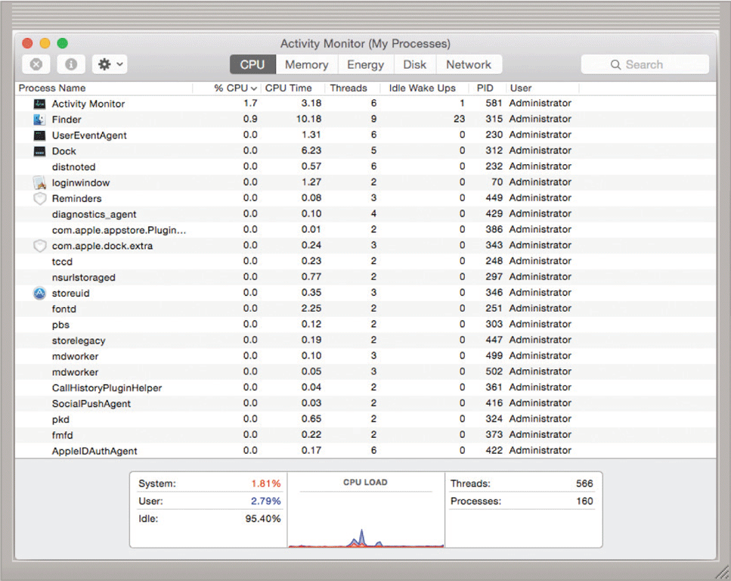
Operating System Functions
A performance monitor is a program that assesses and reports information about various computer resources and devices
Page 420
Figure 9-10

Slide 16
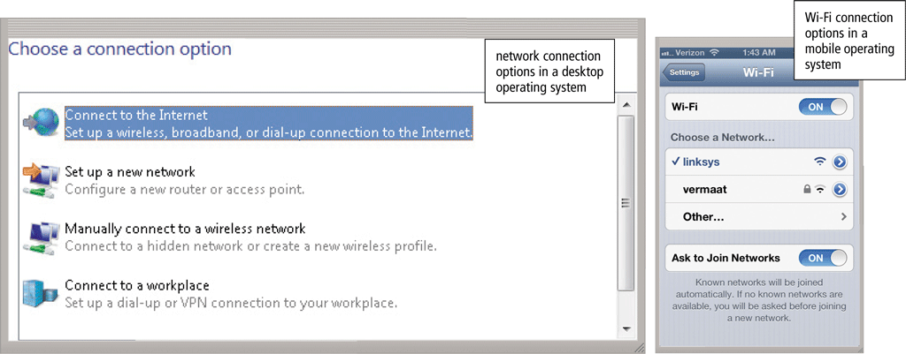
Operating System Functions
Operating systems typically provide a means to establish Internet connections
Page 420
Figure 9-11

Slide 17
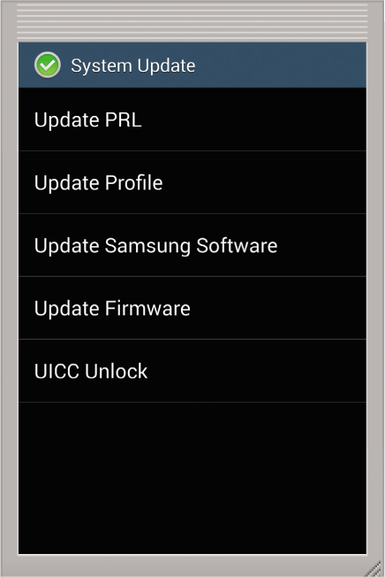
Operating System Functions
Many programs, including operating systems, include an automatic update feature that regularly provides new features or corrections to the program
Page 421
Figure 9-12

Slide 18
Operating System Functions
Operating systems often provide users with a variety of tools related to managing a computer, its devices, or its programs
File Manager
Search
Image Viewer
Uninstaller
Disk Cleanup
Disk Defragmenter
Screen Saver
File Compression
PC Maintenance
Backup and Restore
Page 422

Slide 19
Operating System Functions
Some operating systems are designed to work with a server on a network
These multiuser operating systems allow multiple users to share a printer, Internet access, files, and programs
A network administrator uses the server operating system to:
Add and remove users, computers, and other devices
Configure the network, install software and administer network security
Page 423

Slide 20
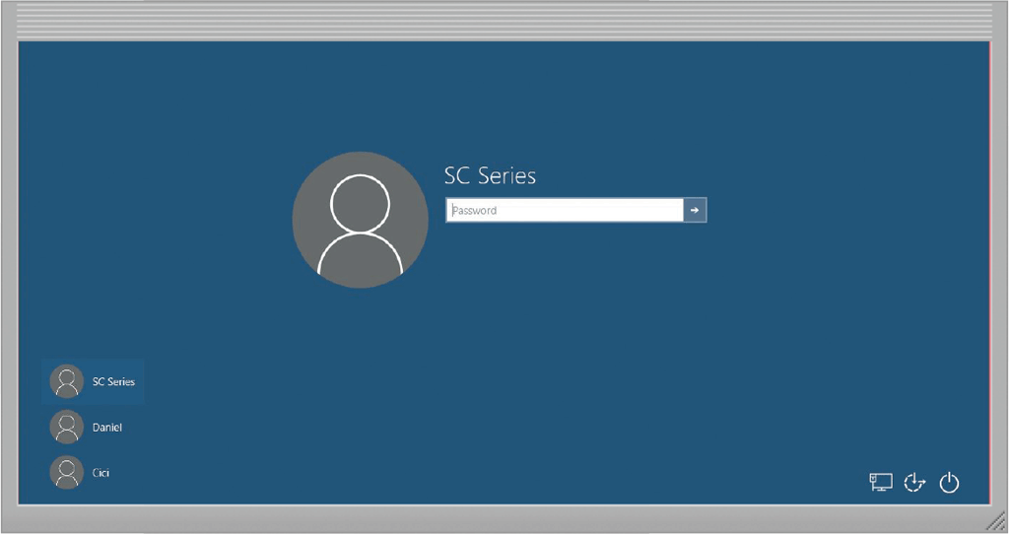
Operating System Functions
A user account enables a use to sign in to, or access resources on, a network or computer
A user name, or user ID, identifies a specific user
A password is a private combination of characters associated with the user name
Pages 423 - 424
Figure 9-13

Slide 21
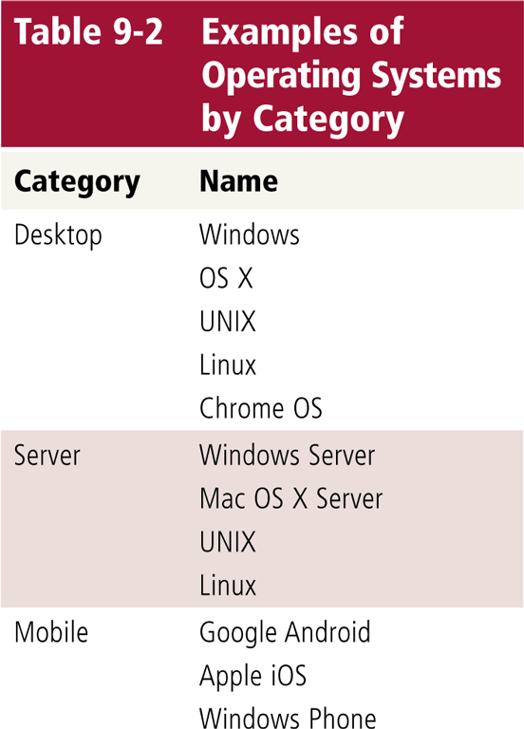
Types of Operating Systems
Page 425
Table 9-2

Slide 22
Desktop Operating Systems
A desktop operating system is a complete operating system that works on desktops, laptops, and some tablets
Windows
Mac OS
UNIX
Linux
Chrome OS
Page 426

Slide 23
Desktop Operating Systems
The latest versions of Windows offer these features
Uses tiles to access apps
Includes the desktop interface
Support for input via touch, mouse, and keyboard
Email app, calendar app, and browser included
Photos, files, and settings you can sync with OneDrive
Enhanced security through an antivirus program, firewall, and automatic updates
Windows Store offers additional applications for purchase
Page 426

Slide 24
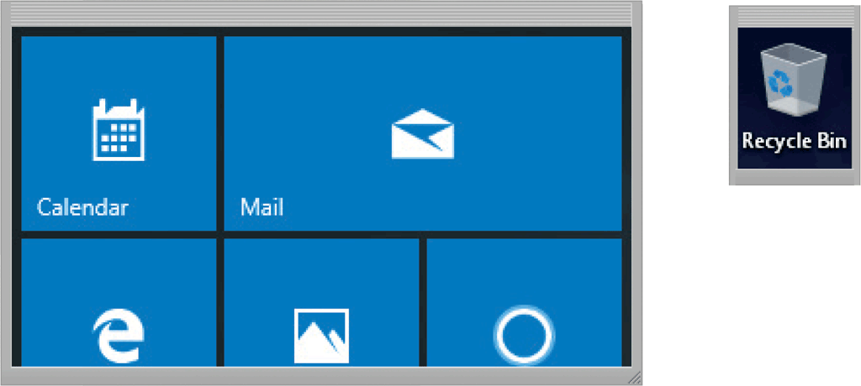
Desktop Operating Systems
Pages 426 - 427

Slide 25
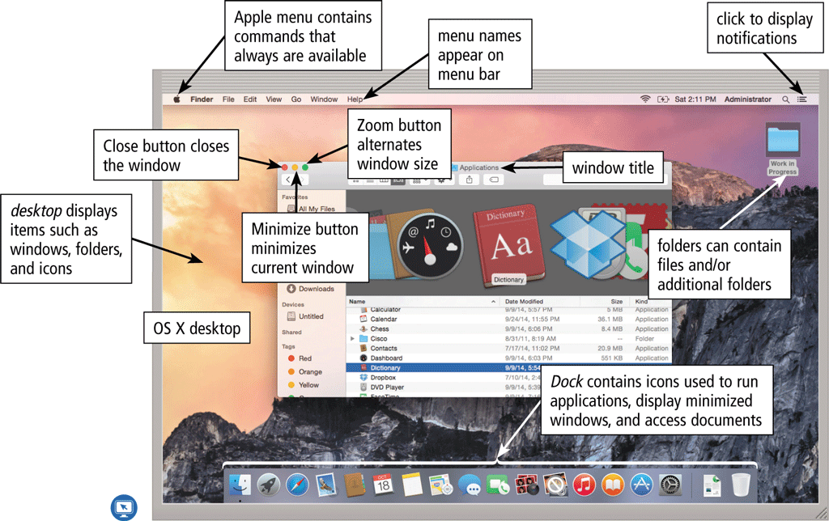
Desktop Operating Systems
The Macintosh operating system has earned a reputation for its ease of use
Latest version is OS X
Pages 427 - 428

Slide 26
Desktop Operating Systems
UNIX is a multitasking operating system developed in the early 1970s
Linux is a popular, multitasking UNIX-based operating system
Pages 429 – 430
Figures 9-14 – 9-15

Slide 27
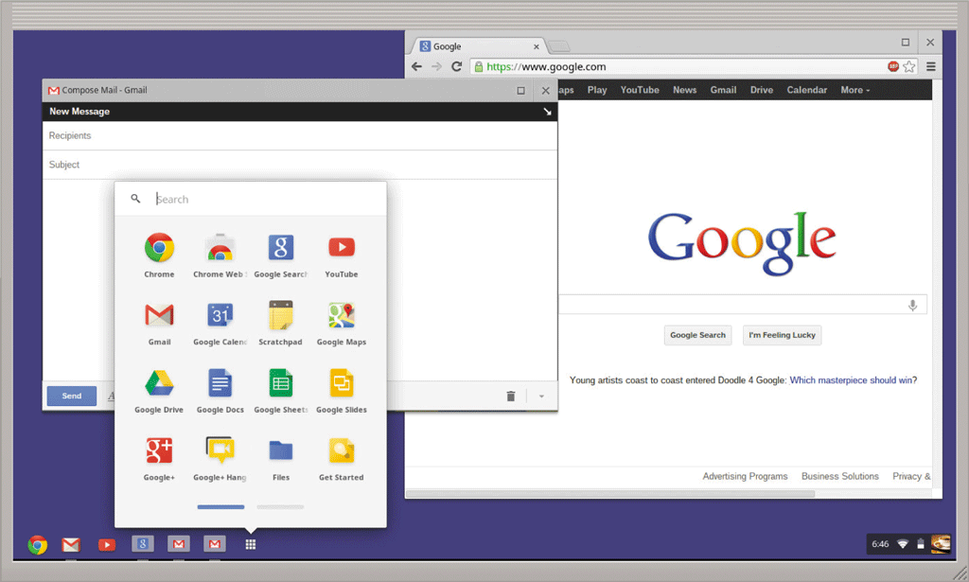
Desktop Operating Systems
Chrome OS is a Linux-based operating system designed to work primarily with web apps
Pages 430 - 431
Figure 9-16

Slide 28
Server Operating Systems
Windows Server
OS X Server
UNIX
Linux
Pages 432 - 433

Slide 29
Mobile Operating Systems
The operating system on mobile devices and many consumer electronics is called a mobile operating system and resides on firmware
Android
iOS
Windows Phone
Pages 433 - 434

Slide 30
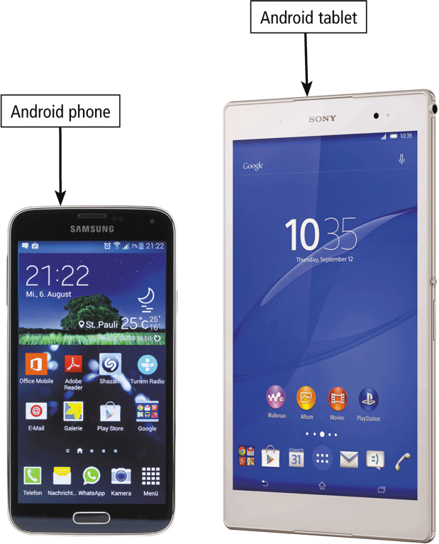
Mobile Operating Systems
Android is an open source, Linux-based mobile operating system designed by Google for smartphones and tablets
Page 434
Figure 9-17

Slide 31
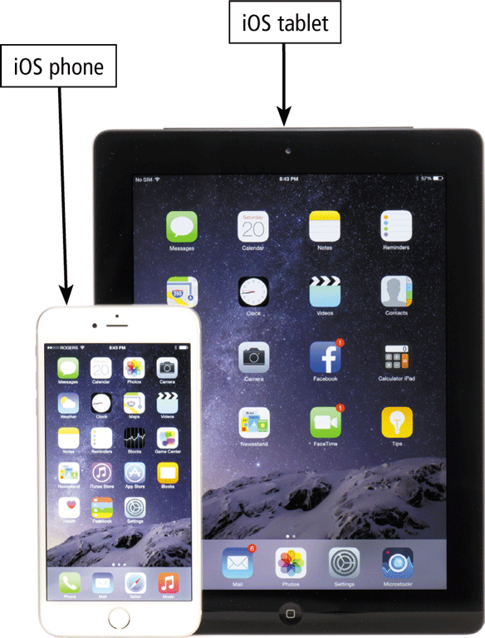
Mobile Operating Systems
iOS, developed by Apple, is a proprietary mobile operating system specifically made for Apple’s mobile devices
Page 434
Figure 9-18

Slide 32
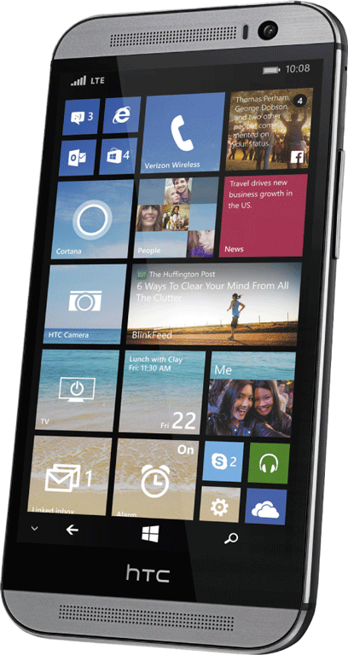
Mobile Operating Systems
Windows Phone, developed by Microsoft, is a proprietary mobile operating system that runs on some smartphones
Page 435
Figure 9-19

Slide 33
Summary
Functions common to most operating systems
Variety of desktop operating systems, server operating systems, and mobile operating systems
Page 437

Slide 34
Chapter 9 Complete

